Slide 1
19Z504 Computer Networks
BE CSE

Slide 2
Syllabus
INTRODUCTION: Building a Network - Network Edge and Core - Layering and Protocols - TCP/IP Protocol suite - OSI Reference Model - Network Topologies – Internet Architecture
PHYSICAL LAYER: Signal Characteristics – Transmission media – Signal Encoding Techniques – Performance Metrics.
LINK LAYER SERVICES: Link Layer Services - Framing - Flow Control - Error Control - Media Access Control - Ethernet - Wireless LAN–Introduction about Bluetooth, Zigbee.

Slide 3
Syllabus
SWITCHING AND ROUTING : Switching : Circuit Switching - Packet Switching - IPV4 - Global Address - Datagram Forwarding - Subnetting - CIDR - ICMP - Routing Algorithms: Distance Vector Routing and Link State Routing - IPV6 Addressing–IPV6 Protocol.
CONNECTION-ORIENTED AND CONNECTION-LESS SERVICES : Overview of Transport Layer - UDP - TCP – Reliable Byte Stream - Connection Management - Flow Control - Congestion Control - SCTP.

Slide 4
Syllabus
APPLICATION LAYER SERVICES: Needs/Principles of Application Layer Protocols – Role of proxy, Web and HTTP - FTP - Electronic Mail (SMTP- POP3 - IMAP- MIME)- DHCP - DNS - DASH - QUIC.
□ Book
1 . Larry L Peterson and Bruce S Davie, ”Computer Networks: A systems approach”, Morgan Kaufmann Publishers, USA, Fifth Edition 2011.
2. James F Kurose, Keith W Ross, ”Computer Networking - A Top-Down Approach Featuring the Internet”, Pearson Education, New Delhi, Sixth Edition, 2012.

Slide 5

Course Outcomes
□ COURSE OUTCOMES
Upon completion of this course, the students will be able to
CO1: understand the components of network architecture and analyze the performance of computer networks with respect to key performance metrics.
CO2: understand the design principles of physical and data link layers
CO3: understand the design issues in host level connectivity, identify the IP address classes and design subnets for different scenarios
CO4: understand the issues involved in establishing process to process connectivity and congestion management
CO5: Outline the protocols for network application development and network management

Slide 6
INTRODUCTION
Building a Network
Network Edge and Core
Layering and Protocols - TCP/IP Protocol suite
OSI Reference Model
Network Topologies
Internet Architecture

Slide 7
Computer Network
An interconnection of multiple devices, also known
as hosts, that are connected using multiple paths for
the purpose of sending/receiving data or media.
include multiple devices/mediums which help in
the communication between two different devices-
Network devices and include things such as
routers, switches, hubs, and bridges.

Slide 8

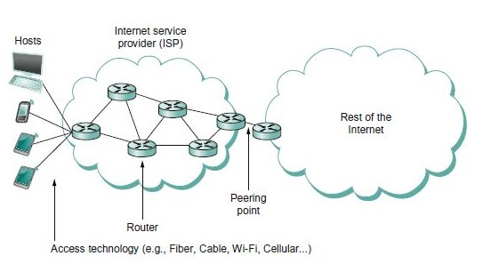
Hardware Building Blocks of Network
Nodes
Computers and other devices in a network
Links
Physical connection between the nodes by coaxial cables or optical fibers.

Slide 9
Connectivity : Direct connection
Nodes are directly connected to each other over a common physical medium.
Types
Point-to-Point
Multiple-access/Multi point
Problems
Number of computers that could be connected by this kind of connection is very limited.
Number of wires coming out of each node can become unmanageable and expensive

Slide 10

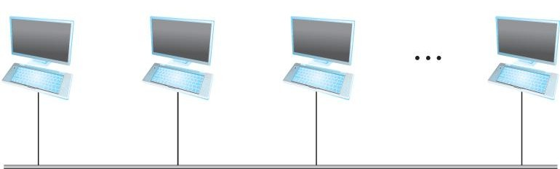
Direct Connection
Point-to-Point:
Links between a pair of nodes
□ .
Multiple-access:
More than two nodes share a single physical link.

Slide 11
Connectivity: Indirect connection
Nodes may be connected to each other by a set of cooperating nodes.
Types
Switched Network
Circuit Switched
Packet Switched.
Internetwork

Slide 12
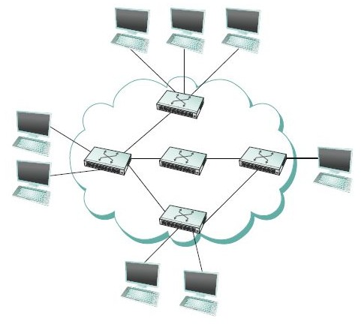

Indirect Connection
Switched Network
Each nodes are attached to one or more point-to-point links.
Nodes that are attached to atleast two links run software that forwards data received from one link to another.
The forwarding nodes form switched network.
Types
Circuit switched
Packet switched

Slide 13
Switched Network
Switches
Primary function
Store-and-forward packets in a packet switched connectivity.
Hosts
Nodes that support users and run application programs.
*The cloud in the diagram is used to represent any type of network(point-to-point, multiple-access or switched network)

Slide 14
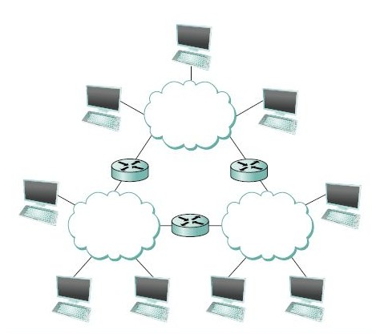
Indirect Connection
Internetwork/Internet
Set of independent networks connected together
Router or gateway
A node that is connected to two or more networks.
It forwards messages from one network to another.
*Internet can be viewed as another kind of
network-interconnection of internets.

Slide 15
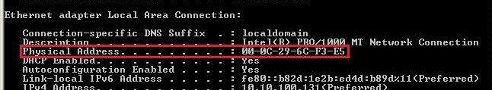

Addressing
Byte string that identifies a node
Network can use a node’s address to distinguish it from the other nodes connected to the network.

Slide 16
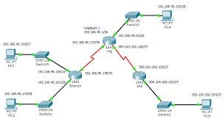
Routing
The process of determining systematically how to forward
messages towards the destination node based on it address

Slide 17
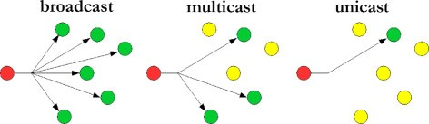

Communication types
Unicast
Source node sends a message to a single destination node
Broadcast
Source node sends a message to all the nodes on the network.
Multicast
Source node sends a message to a subset of nodes but not all nodes.
*A network must support multicast and broadcast address in addition to node-specific address

Slide 18
Networks
Two or more nodes connected by a physical link.
Two or more networks connected by a node.

Slide 19
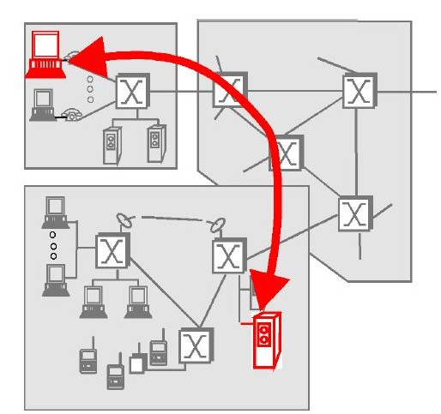
The Network Edge
- Components which we use on daily basis
Hosts
Computers that we use on a daily basis are referred to as hosts or end systems.
The run application level programs-Eg web browser, server program, email etc…
They sit at the “edge” of the Internet.
Two categories:
Client
Server

Slide 20
The Network Edge
Clients
Often tends to be PCs, workstation, etc…
Server
Often tends to be more powerful machines.
A client program running on one end system requests and receives information from a server running on another end system

Slide 21
Connectionless &
Connection-Oriented Services
A developer creating an Internet application (e.g., an email application, a file transfer application, a Web application or an Internet phone application) must program the application to use one of these two services:
Connectionless
Connection Oriented

Slide 22
Connection Oriented
When an application uses the connection-oriented service, the client and the server (residing in different end systems) send control packets to each other before sending packets with real data. Eg:e-mail etc.
Handshaking procedure-alerts the client and server, allowing them to prepare for movement of packets
Only the end systems themselves are aware of this connection.
The components within the Internet are completely unaware to the connection
The internet’s connection oriented service-TCP(Transmission Control Protocol)

Slide 23
Connectionless
One side of an application wants to send packets to another side of an application, the sending application simply sends the packets.
Eg: Telnet(remote login), HTTP etc…
No handshaking procedure.
Hence faster delivery of data.
The internet’s connectionless service- UDP (User Datagram Protocol)

Slide 24
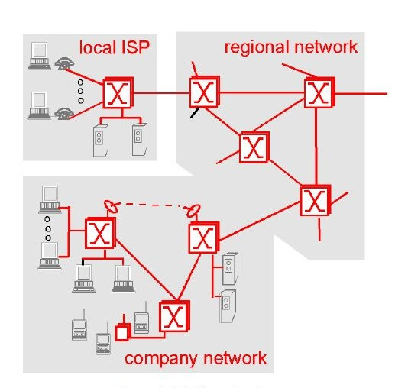
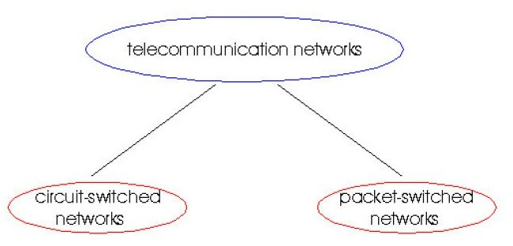
Network Core
Inside of a network
Two fundamental approaches in building network core
Circuit Switching
Packet Switching

Slide 25
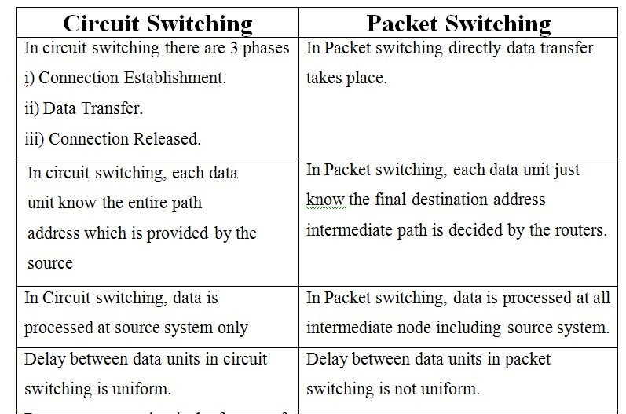
Circuit Switching Vs Packet Switching

Slide 26
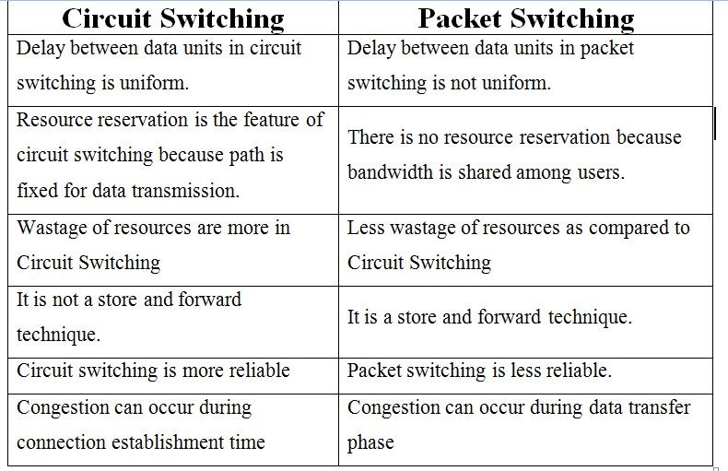
Circuit Switching Vs Packet Switching

Slide 27
Network Architecture
A computer network must provide general, cost effective, fair, and robust connectivity among a large number of computers.
To help deal with this complexity, network designers have developed general Blueprints usually called network architectures that guide the design and implementation of networks.

Slide 28
Layered Architecture
A communication subsystem is a complex piece of Hardware
and software.
for implementing the software for such subsystems were based on
a single, complex, unstructured program with many interacting
components.
The resultant software was very difficult to test and modify.
To overcome such problem, the ISO has developed a layered
approach.
Networking concept is divided into several layers, and each layer is assigned a particular task.
- networking tasks depend upon the layers.

Slide 29
Layered Architecture
The main aim of the layered architecture is to divide the design
into small pieces.
Each lower layer adds its services to the higher layer to provide a
full set of services to manage communications and run the
applications.
It provides modularity and clear interfaces, i.e., provides
interaction between subsystems.
It ensures the independence between layers by providing the
services from lower to higher layer without defining how the
services are implemented. Therefore, any modification in a layer will not affect the other layers.

Slide 30
Layered Architecture
The number of layers, functions, contents of each layer will vary
from network to network.
However, the purpose of each layer is to provide the service from
lower to a higher layer and hiding the details from the layers of how
the services are implemented.
The basic elements of layered architecture are services, protocols, and interfaces.
Service: It is a set of actions that a layer provides to the higher layer.
Protocol: It defines a set of rules that a layer uses to exchange the information with peer entity. These rules mainly concern about both the contents and order of the messages used.
Interface: It is a way through which the message is transferred from one layer to another layer.
In a layer n architecture, layer n on one machine will have a communication with the layer n on another machine and the rules used in a conversation are known as a layer-n protocol.

Slide 31
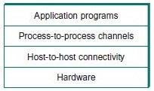
Features of layering
Decompose the problem of building a network into more manageable components.
Provides modular design-for adding new features/services, need to modify the functionality at one layer.

Slide 32
Protocols
A protocol is a standard set of rules that allow electronic devices to communicate with each other.
These rules include what type of data may be transmitted, what commands are used to send and receive data, and how data transfers are confirmed.
Provides a communication service that higher-level objects use to exchange messages.

Slide 33
Two interfaces of each protocols
Service interface
Defines interface to other objects on the same computer that want to use its communication services.
Defines the operations that local objects can perform on the protocol.
Peer interface
Defines interface to its counterpart(peer) on another machine.
Defines the form and meaning of messages exchanged between protocol peers to implement the communication service.

Slide 34
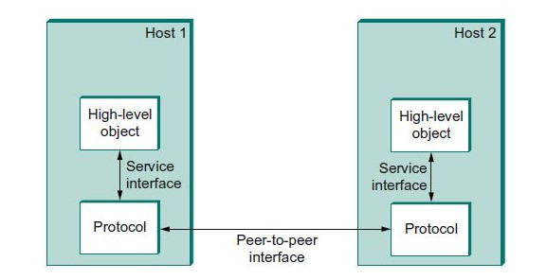
Two interfaces of each protocols
□ Protocol defines a communication service that it exports locally(service interface) along with a set of rules governing the messages that the protocol exchanges with its peers to implement the service(peer interface)

Slide 35
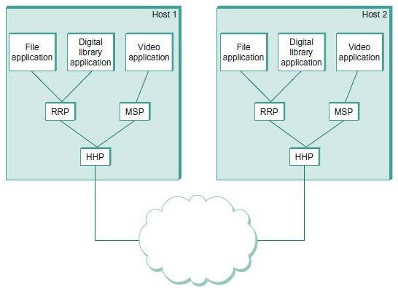
Protocol Graph
Represent the suite of protocols that make up a network system with a protocol graph
Each protocol communicates with its peer by passing messages to some lower level protocol, which in turn delivers the message to its peer.
The nodes of the graph correspond to protocols,
The edges represent a depends on relation
RRP- Request/Reply Protocol MSP-Message Stream Protocol HHP-Host-to-Host Protocol
*The application is said to employ the services of the protocol stack RRP/HHP.

Slide 36
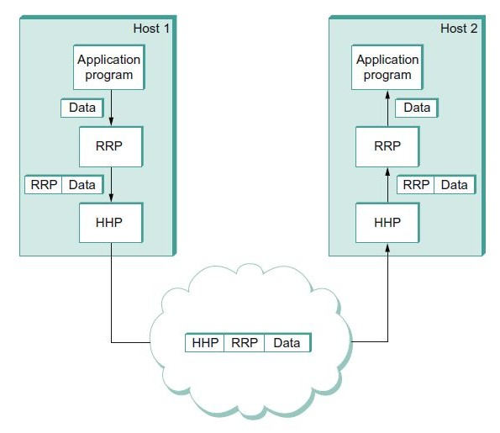
Protocol Graph
Consider application programs sends a message to its peer through RRP and HHP.
information to its peer, instructing it how to handle the message when it is received.
RRP attaches header to the message exact format for the header attached by RRP is defined by its protocol specification application’s data is encapsulated in the new
message created by RRP.
HHP then encapsulates RRP’s message by attaching a header of its own
At destination, HHP first interprets the HHP header at the front of the message passes the body of the message up to RRP.
RRP takes whatever action is indicated by the RRP header that its peer attached and passes the body of the message up to the application program.
.

Slide 37
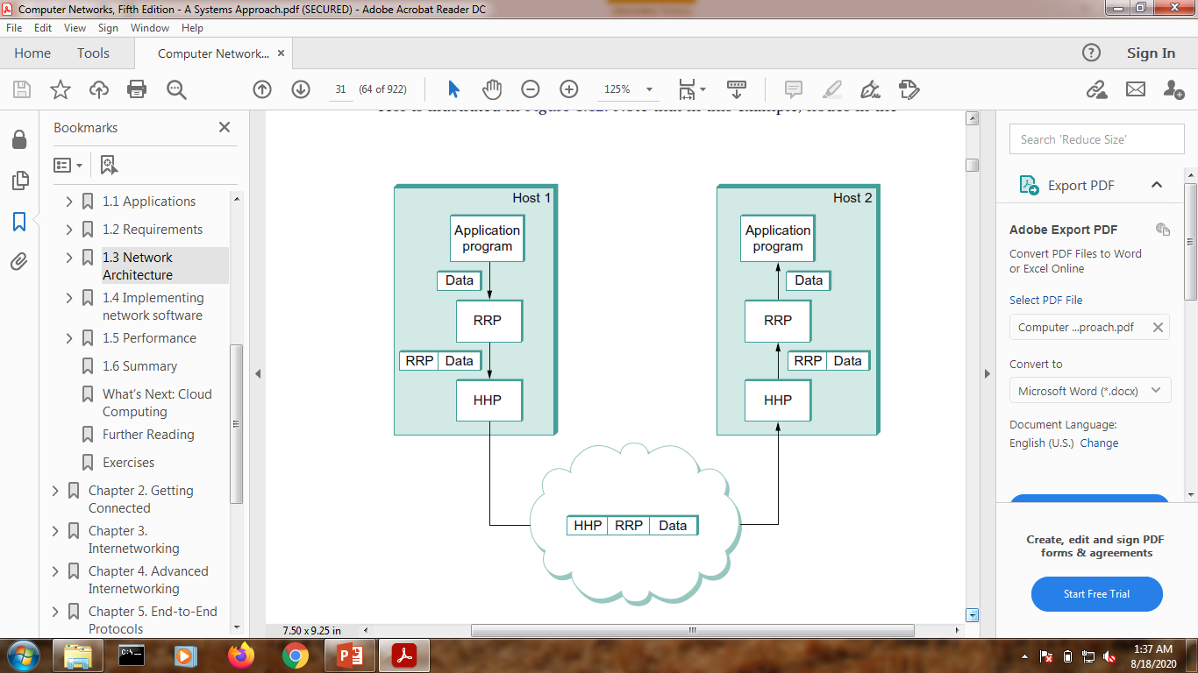
Encapsulation
Consider application programs sends a message to its peer through RRP and HHP.
At source, RRP must communicate control information to its peer, instructing it how to handle the message when it is received RRP attaches header to the message exact format for the header attached by RRP is defined by its protocol specification application’s data is encapsulated in the new message created by RRP.
HHP then encapsulates RRP’s message by attaching a header of its own At destination, HHP first interprets the HHP header at the front of the message passes the body of the message up to RRP.
RRP takes whatever action is indicated by the RRP header that its peer attached and passes the body of the message up to the application program.

Slide 38
Encapsulation
A header is a small data structure(few bytes) is used among
peers to communicate with each other. Is also attached to the front of a message.
In some cases, control information is sent at the end of the message, in which case it is called a trailer.
The data being transmitted on behalf of the application is called the message’s body or payload
Encapsulation is the operation, performed by a lower-level protocol, of attaching a protocol-specific header and/or trailer to a message passed down by a higher-level protocol.

Slide 39
Why do we require Layered architecture?
Divide-and-conquer approach: Divide-and-conquer approach makes a design process in such a way that the unmanageable tasks are divided into small and manageable tasks. In short, we can say that this approach reduces the complexity of the design.
Modularity: Layered architecture is more modular. Modularity provides the independence of layers, which is easier to understand and implement.
Easy to modify: It ensures the independence of layers so that implementation in one layer can be changed without affecting other layers.
Easy to test: Each layer of the layered architecture can be analyzed and tested individually.

Slide 40
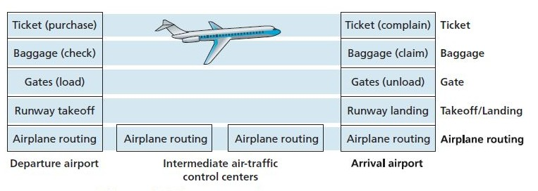
Layered Approach!!!

Slide 41
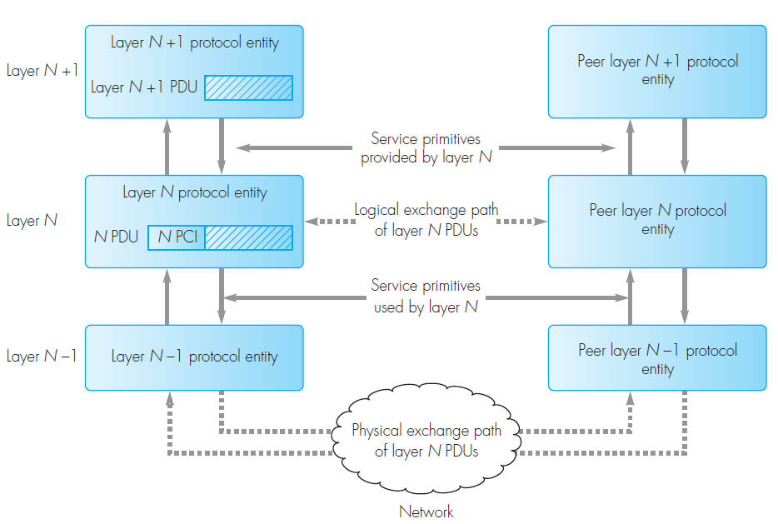
Layer Interactions

Slide 42
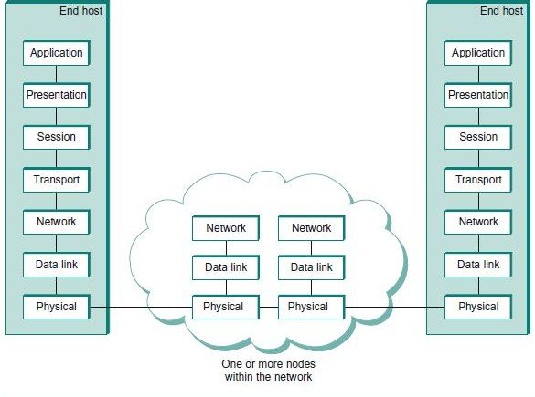
7-Layer Model-Open Systems Interconnection(OSI) Architecture.

Slide 43
Layer 1: Physical layer
The physical layer coordinates the functions required to carry a bit stream
over a physical medium.
It deals with the mechanical and electrical specifications of the interface
and transmission medium.
It also defines the procedures and functions that physical devices and
interfaces have to perform for transmission to occur.
“The physical layer is responsible for movements of individual bits from one hop (node) to the next”

Slide 44
Layer 1: Physical layer
Services Provided
Physical characteristics of interfaces and medium.
The physical layer defines the characteristics of the interface between the devices and the transmission medium.
It also defines the type of transmission medium.
Representation of bits.
The physical layer data consists of a stream of bits (sequence of 0s or 1s) with no interpretation.
To be transmitted, bits must be encoded into signals--electrical or optical.
The physical layer defines the type of encoding (how 0s and 1s are changed to signals).
Data rate.
The transmission rate: the number of bits sent each second.
(ie) the physical layer defines the duration of a bit, which is how
long it lasts.
Synchronization of bits.
The sender and receiver not only must use the same bit rate but also must be synchronized at the bit level.
(ie)the sender and the receiver clocks must be synchronized.

Slide 45
Physical layer
Line configuration.
The physical layer is concerned with the connection of devices to the media.
point-to-point configuration: Two devices are connected through a dedicated link.
multipoint configuration: a link is shared among several devices.
Physical topology.
The physical topology defines how devices are connected to make a network.
mesh topology: every device is connected to every other device
star topology: devices are connected through a central device
ring topology: each device is connected to the next, forming a ring
bus topology: every device is on a common link
hybrid topology: this is a combination of two or more topologies
Transmission mode
The physical layer also defines the direction of transmission between two devices
simplex mode: only one device can send; the other can only receive(a one-way communication).
half-duplex mode: two devices can send and receive, but not at the same time.
full-duplex (or simply duplex) mode: two devices can send and receive at the same time.

Slide 46
Layer 2: Data link layer
The data link layer transforms the physical layer, a raw transmission
facility, to a reliable link.
Collects a stream of bits into a larger aggregate called a frame. Frames are actually delivered to the host.
It makes the physical layer appear error-free to the upper layer (network
layer).
Network Adaptors along with device drivers running in the node’s operating system implement the data link level.
Oversees the delivery of the data units between two systems on the same network (links)
“The data link layer is responsible for moving frames from one hop (node) to the next”
Services Provided
Framing
The data link layer divides the stream of bits received from the network layer into
manageable data units called frames.

Slide 47
Data link layer
Services Provided
Physical addressing
If frames are to be distributed to different systems on the network, the data link layer
adds a header to the frame to define the sender and/or receiver of the frame.
If the frame is intended for a system outside the sender's network, the receiver address
is the address of the device that connects the network to the next one.
Flow control
If the rate at which the data are absorbed by the receiver is less than the rate at
which data are produced in the sender, the data link layer imposes a flow
control mechanism to avoid overwhelming the receiver.
Error control.
The data link layer adds reliability to the physical layer by adding mechanisms to
detect and retransmit damaged or lost frames.
It also uses a mechanism to recognize duplicate frames.
Error control is normally achieved through a trailer added to the end of the frame.
Access control
When two or more devices are connected to the same link, data link layer protocols are
necessary to determine which device has control over the link at any given time.

Slide 48
Layer 3: Network layer
The network layer is responsible for the source-to-destination delivery of
a packet, possibly across multiple networks (links).
The network layer ensures that each packet gets from its point of origin
to its final destination.
If two systems are connected to the same link, there is usually no need
for a network layer.
If the two systems are attached to different networks (links) with
connecting devices between the networks (links), there is often a need for
the network layer to accomplish source-to-destination delivery.
The unit of data exchanged among nodes is typically called packet.
“The network layer is responsible for the delivery of individual packets from the source host to the destination host”

Slide 49
Network layer
Services Provided
Logical addressing.
The physical addressing implemented by the data link layer handles the addressing problem locally.
If a packet passes the network boundary, we need another addressing system to help distinguish the source and destination systems.
The network layer adds a header to the packet coming from the upper layer that, among other things, includes the logical addresses of the sender and receiver.
Routing.
When independent networks or links are connected to create intenetworks (network of networks) or a large network, the connecting devices (called routers or switches) route or switch the packets to their final destination.
The network layer gets each packet to the correct computer.

Slide 50
Layer 4: Transport layer
The transport layer is responsible for process-to-process delivery of the entire message.
A process is an application program running on a host.
The network layer oversees source-to-destination delivery of individual packets, it does not
recognize any relationship between those packets.
It treats each one independently, as though each piece belonged to a separate message, whether or not it does.
The transport layer ensures that the whole message arrives intact and in order, overseeing
both error control and flow control at the source-to- destination level.
“The transport layer is responsible for the delivery of a message from one process to another.”
Services Provided:
Service-point addressing
Computers often run several programs at the same time.
source-to-destination delivery means delivery not only from one computer to the next but also from a specific process (running program) on one computer to a specific process (running program) on the other.
The transport layer header must therefore include a type of address called a service-point address (or port address).
Gets the entire message to the correct process on a computer.

Slide 51
Transport layer
Segmentation and reassembly.
A message is divided into transmittable segments, with each segment containing a sequence number.
These numbers enable the transport layer to reassemble the message correctly upon arriving at the destination and to identify and replace packets that were lost in transmission.
Connection control.
The transport layer can be either connectionless or connection-oriented. A connectionless transport layer treats each segment as an independent packet and delivers it to the transport layer at the destination machine.
A connection oriented transport layer makes a connection with the transport layer at the destination machine first before delivering the packets. After all the data are transferred, the connection is terminated.
Flow control.
Like the data link layer, the transport layer is responsible for flow control. Flow control at this layer is performed end to end rather than across a single link.
Error control.
error control at this layer is performed process-to-process rather than across a single link.
The sending transport layer makes sure that the entire message arrives at the receiving transport layer without error (damage, loss, or duplication).
Error correction is usually achieved through retransmission.

Slide 52
Layer 5: Session layer
The services provided by the first three layers (physical, data link, and network)
are not sufficient for some processes.
The session layer is the network dialog controller.
It establishes, maintains, and synchronizes the interaction among
communicating systems.
“The session layer is responsible for dialog control and synchronization.”
Services Provided:
Dialog control.
The session layer allows two systems to enter into a dialog.
It allows the communication between two processes to take place in either half-duplex (one way at a time) or full-duplex (two ways at a time) mode.

Slide 53
Session layer
Synchronization.
The session layer allows a process to add checkpoints, or synchronization points, to a stream of data.
For example:
If a system is sending a file of 2000 pages, it is advisable to insert checkpoints after every 100 pages to ensure that each 100-page unit is received and acknowledged independently.
In this case, if a crash happens during the transmission of page 523, the only pages that need to be resent after system recovery are pages 501 to 523. Pages previous to 501 need not be resent.
Managing an audio and a video stream that are being combined in a teleconferencing application.

Slide 54
Layer 6: Presentation layer
The presentation layer is concerned with the syntax and semantics of the
information exchanged between two systems.
(ie) Concerned with the format of data exchanged between peers.
“The presentation layer is responsible for translation, compression, and encryption.”
Services Provided:
Translation.
The processes (running programs) in two systems are usually exchanging
information in the form of character strings, numbers, and so on.
The information must be changed to bit streams before being transmitted. Because
different computers use different encoding systems, the presentation layer is
responsible for interoperability between these different encoding methods.
The presentation layer at the sender changes the information from its sender-
dependent format into a common format.
The presentation layer at the receiving machine changes the common format into
its receiver-dependent format.
Eg:
whether integer is 16,32 or 64 bits long;
whether the most significant byte is transmitted first of last how the video streaming is formatted

Slide 55
Presentation layer
Services Provided
Encryption.
To carry sensitive information, a system must be able to ensure privacy.
Encryption means that the sender transforms the original information to another form
and sends the resulting message out over the network.
Decryption reverses the original process to transform the message back to its original
form.
Compression.
Data compression reduces the number of bits contained in the information.
Data compression becomes particularly important in the transmission of multimedia such
as text, audio, and video.

Slide 56
Layer 7: Application layer
The application layer enables the user, whether human or software, to
access the network.
It provides user interfaces and support for services such as electronic
mail, remote file access and transfer, shared database management, and
other types of distributed information services.
“The application layer is responsible for providing services to the user.”
Services Provided:
Network virtual terminal.
A network virtual terminal is a software version of a physical terminal, and it allows a user to log on to a remote host.
To do so, the application creates a software emulation of a terminal at the remote host.
The user's computer talks to the software terminal which, in turn, talks to the host, and vice versa.
The remote host believes it is communicating with one of its own terminals and allows the user to log on.
The lower three layers are implemented on all network nodes.
The transport and the higher layers run only on end hosts

Slide 57
Application layer
File transfer, access, and management.
This application allows a user
to access files in a remote host (to make changes or read data),
to retrieve files from a remote computer for use in the local computer,
to manage or control files in a remote computer locally.
Mail services.
This application provides the basis for e-mail forwarding and storage.
Directory services.
This application provides distributed database sources and access for global information about various objects and services.

Slide 58
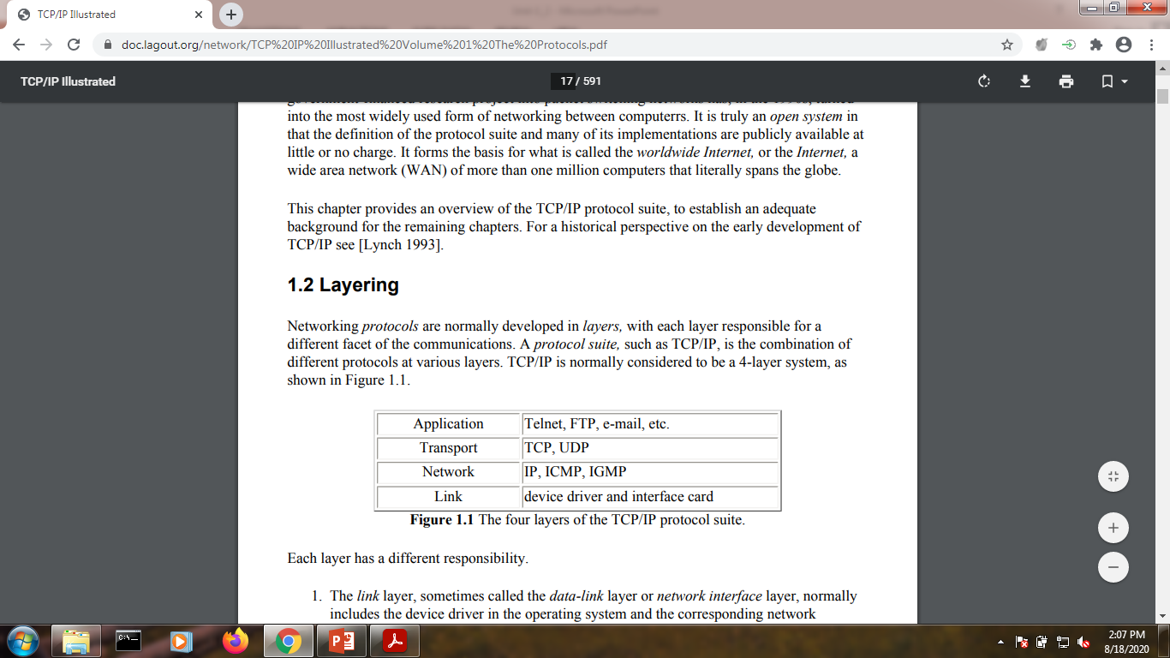
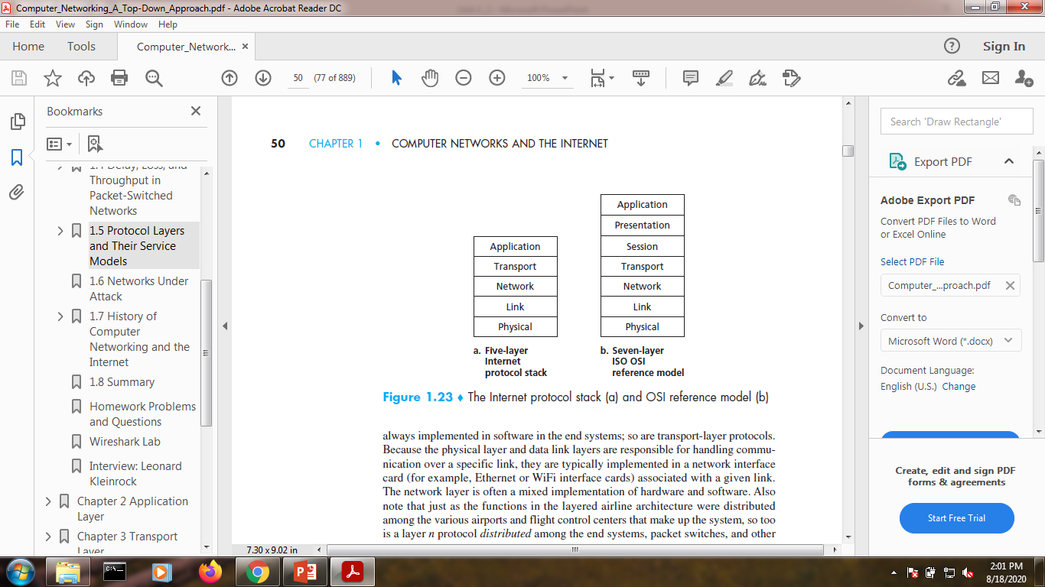
TCP/IP Protocol Suite
The TCP/IP protocol suite was developed prior to the
OSI model.
The layers in the TCP/IP protocol suite do not exactly
match those in the OSI model.
The original TCP/IP protocol suite was defined as
having four layers.
Internet’s TCP/IP protocol suite is made of five layers
TCP/IP is a hierarchical protocol made up of
interactive modules, each of which provides a
specific functionality;.
The modules are not necessarily interdependent.
The term hierarchical means that each upper-level protocol is supported by one or more lower-level protocols.
The layers of the TCP/IP protocol suite contain relatively independent protocols that can be mixed and matched depending on the needs of the system.

Slide 59
Physical and Data Link Layers
At the physical and data link layers, TCP/IP does not define any
specific protocol.
It supports all the standard and proprietary protocols.
A network in a TCP/IP internetwork can be a local-area network or a wide-area network.

Slide 60
Network Layer
ARP, Internetworking Protocol(IP), is a host-to-host protocol,
meaning that it can deliver a packet from one physical device to
another.
At the network layer (internetwork layer), TCP/IP supports the
Internetworking Protocol(IP), in turn, uses four supporting
protocols:
RARP,
ICMP,
IGMP.

Slide 61
Network Layer
Internetworking Protocol (IP)
The Internetworking Protocol (IP) is the transmission mechanism used by the TCP/IP protocols.
It is an unreliable and connectionless protocol with a best-effort delivery service.
The term best effort means that IP provides no error checking or tracking.
IP assumes the unreliability of the underlying layers and does its best to get a transmission through its destination, but with no guarantees.
IP transports data in packets called datagrams, each of which is transported separately.
Datagrams can travel along different routes and can arrive out of sequence or be duplicated.
IP does not keep track of the routes and has no facility for reordering datagrams once they arrive at their destination.
IP provides bare-bones transmission functions that free the user to add only those facilities necessary for a given application and thereby allows for maximum efficiency.

Slide 62
Network Layer
Address Resolution Protocol
The Address Resolution Protocol (ARP) is used to associate a logical address with a physical address.
On a typical physical network, such as a LAN, each device on a link is identified by a physical or station address, usually imprinted on the network interface card (NIC).
ARP is used to find the physical address of the node when its Internet address is known
Reverse Address Resolution Protocol
The Reverse Address Resolution Protocol (RARP) allows a host to discover its Internet address when it knows only its physical address.
It is used when a computer is connected to a network for the first time or when a disk of computer is booted.

Slide 63
Network Layer
Internet Control Message Protocol
The Internet Control Message Protocol (ICMP) is a mechanism used by hosts and gateways to send notification of datagram problems back to the sender.
ICMP sends query and error reporting messages.
Internet Group Message Protocol
The Internet Group Message Protocol (IGMP) is used to facilitate the simultaneous transmission of a message to a group of recipients.

Slide 64
Transport Layer
Traditionally the transport layer was represented in TCP/IP by two protocols:
TCP
UDP
UDP and TCP are transport level protocols responsible for delivery of a message
from a process (running program) to another process.
A new transport layer protocol) , has been devised to meet the needs of some newer applications.

Slide 65
Transport Layer
User Datagram Protocol
The User Datagram Protocol (UDP) is the simpler of the two standard TCP/IP transport protocols.
It is a process-to-process protocol that adds only port addresses, checksum error control, and length information to the data from the upper layer
Transmission Control Protocol
The Transmission Control Protocol (TCP) provides full transport-layer services to applications.
TCP is a reliable stream transport protocol.
The term stream, in this context, means connection-oriented:
A connection must be established between both ends of a transmission before either can transmit data.
At the sending end of each transmission, TCP divides a stream of data into smaller units called segments.
Each segment includes a sequence number for reordering after receipt, together with an acknowledgment number for the segments received.
Segments are carried across the internet inside of IP datagrams.
At the receiving end, TCP collects each datagram as it comes in and reorders the transmission based on sequence numbers.
Stream Control Transmission Protocol
The Stream Control Transmission Protocol (SCTP) provides support for newer applications such as voice over the Internet.
It is a transport layer protocol that combines the best features of UDP and TCP.

Slide 66
Application Layer
The application layer in TCP/IP is equivalent to the combined session,
presentation, and application layers in the OSI model Many protocols are
defined at this layer.
Egs: The Internet’s application layer includes many protocols:
HTTP protocol - which provides for Web document request and transfer,
SMTP - which provides for the transfer of e-mail messages,
FTP - which provides for the transfer of files between two end systems

Slide 67
TCP/IP Architecture (Encapsulation)
Suppose Alice, who is in one branch office, wants to send a memo to Bob, who is in another branch office.
The memo is analogous to the application-layer message.
Alice puts the memo in an interoffice envelope with Bob’s name and department written on the front of the envelope.
The interoffice envelope is analogous to a transport-layer segment—it contains header information (Bob’s name and department) and it encapsulates the application-layer message (the memo).
When the sending branch-office mailroom receives the interoffice envelope, it puts the interoffice envelope inside yet another envelope, which is suitable for sending through the public postal service.
The sending mailroom also writes the postal address of the sending and receiving branch offices on the postal envelope.
Here, the postal envelope is analogous to the datagram—it encapsulates the transport-layer segment (the interoffice envelope), which encapsulates the original message (the memo).
The postal service delivers the postal envelope to the receiving branch office mailroom. There, the process of de-encapsulation is begun.
The mailroom extracts the interoffice memo and forwards it to Bob.
Finally, Bob opens the envelope and removes the memo.

Slide 68
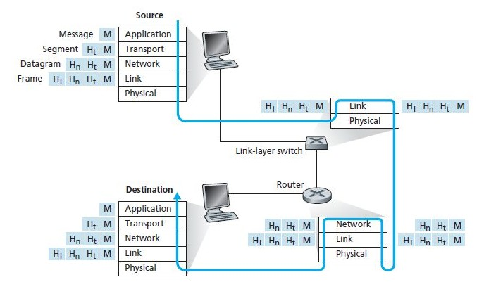
TCP/IP Architecture

Slide 69
Older model of TCP/IP often show only four layers, combining the physical and data link layers.

Slide 70
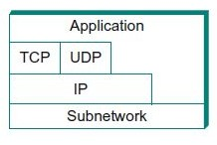
4-Layer Model-TCP/IP Architecture

Slide 71
Features of Internet Architecture
Does not imply strict layering
Eg: application is free to bypass the defined transport layers and to directly use IP or one of the underlying networks.
Programmers are free to define new channel abstractions or applications that run on top of any of the existing protocols.
IP servers as the focal point for the architecture
Defines a common method for exchanging packets among a wide collection of networks.
In order for a new protocol to be officially included in the architecture, there must be both a protocol specification and at least one representative implementations of the specification.

Slide 72
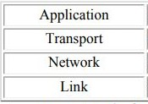
4-Layer Model-TCP/IP Architecture

Slide 73
TCP/IP Architecture
Subnetwork
Implemented by the combination of hardware(network adaptor) and software(network device drivers)
Eg protocols: Ethernet or wireless protocols
Internet Protocol(IP)
Supports the interconnection of multiple networking technologies into a single, logical internetwork.
TCP/UDP
Contains two main protocols-TCP,UDP
TCP-provides a reliable byte-stream channel
UDP-provides an unreliable datagram delivery channel.
TCP & UDP-sometimes called end-to-end protocols/transport protocols
Application Layer
Application Protocols-HTTP,FTP, Telnet, SMTP etc that enable the interoperation of popular applications.

Slide 74
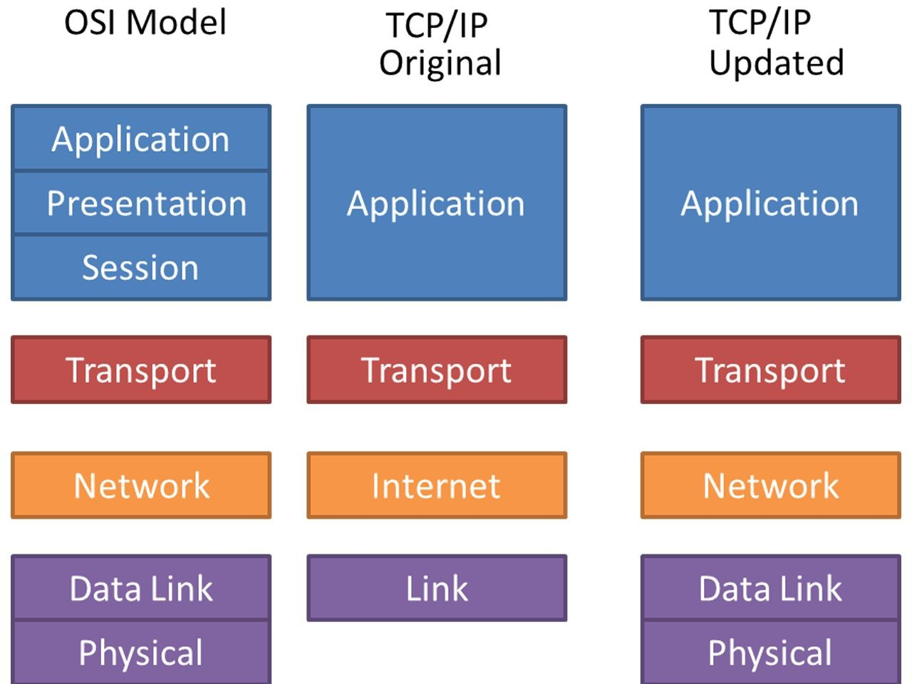
OSI Vs TCP/IP

Slide 75
TCP/IP and OSI
TCP/IP architecture has come to dominate.
There are a number of reasons for this outcome.
Perhaps the most important is that the key TCP/IP protocols were mature and well tested at a time when similar OSI protocols were in the development stage.
When businesses began to recognize the need for interoperability across networks, only TCP/IP was available and ready to go.
Another reason is that the OSI model is unnecessarily complex, with seven layers to accomplish what TCP/IP does with fewer layers

Slide 76
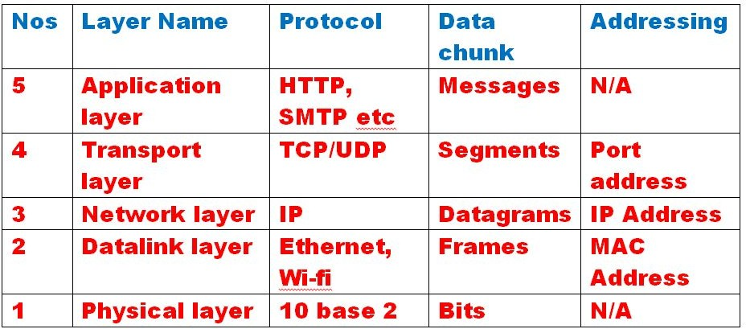
TCP/IP Model

Slide 77
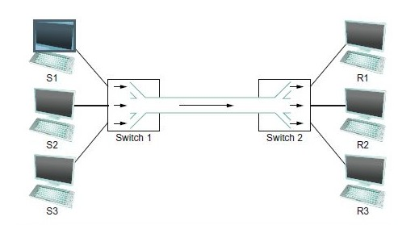
How hosts share a network?
Multiplexing
System resource is shared among multiple users.
Data being sent by multiple users can be multiplexed over the physical link that make
Here, three flows of data,
up a network.
corresponding to three hosts are multiplexed by ‘switch 1’ and then demultiplexed back into separate flow by ‘switch 2’.

Slide 78
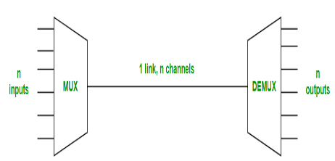
Multiplexing
Multiplexing is the sharing of a medium or bandwidth. It is the process in which multiple signals coming from multiple sources are combined and transmitted over a single communication/physical line.
Multiplexing divides the high capacity medium into low capacity logical medium which is then shared by different streams.
All mediums are capable of multiplexing.
Types of Multiplexing
Frequency Division Multiplexing (FDM)
Time-Division Multiplexing (TDM)
Wavelength Division Multiplexing (WDM)

Slide 79
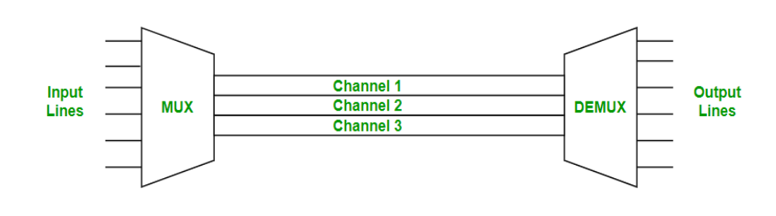
Frequency Division Multiplexing
Separation of the whole spectrum into smaller frequency bands
A channel gets a certain band of the spectrum for the whole time
Frequency Division Multiplexing is used in radio and television transmission.
Advantages:
no dynamic coordination necessary
Disadvantages:
waste of bandwidth if the traffic is distributed unevenly
Inflexible
guard spaces

Slide 80
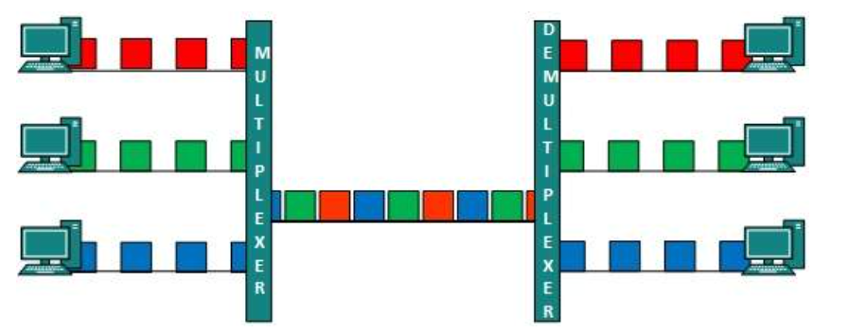
Time Division Multiplexing
A channel gets the whole spectrum for a certain amount of time
A more flexible multiplexing scheme for typical mobile
communications
Advantages:
only one carrier in the medium at any time
throughput high even for many users
Disadvantages:
If two transmissions overlap in time, this is called co-channel interference (precise synchronization necessary)

Slide 81
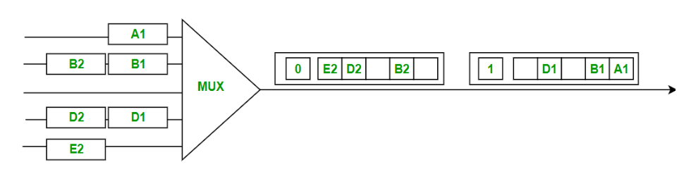
Methods of TDM
Synchronous Time Division Multiplexing(STDM)
Divide time into different size quanta and in round robin fashion, give each flow a chance to send its data over the physical link.
Limitations of STDM and FDM
If one of the flows(host) does not have any data to send, its share of the physical link(time quantum or frequency) remains idle even if one of the other hosts has data to transmit.

Slide 82
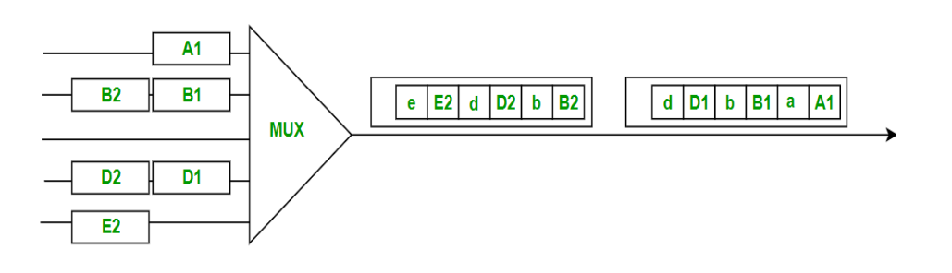
Methods of multiplexing
Statistical Multiplexing
Physical link is shared over time(like STDM)
Data is transmitted from each flow on demand rather than using a predetermined time slot(unlike STDM)
Hence, the avoidance of idle time gives packet switching its efficiency.
To ensure that all the flows eventually get their turn to transmit over the physical link, it defines an upper bound on the size of the block of data that each flow is permitted to transmit at a given time.

Slide 83
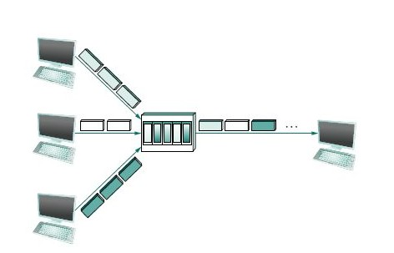
Packet
The limited-size block of data is typically referred to as a packet(unlike, large message that an application program might want to transmit.)
The host sends a sequence of packets over the physical link.
Switch multiplexing packets!!

Slide 84

Which packet to send next(by a switch) on a shared link?
Each switch in a
packet-switched network makes this decision independently on a packet-by-packet basis.
Approaches:
First-In-First-Out(FIFO)
Round-Robin
Switch can receive packets faster than the shared link can accommodate. Hence the packets are buffed in switch’s memory.
If the switch run out of buffer space, some packets are dropped. This operating state is called Congested.
Switch multiplexing packets!!

Slide 85
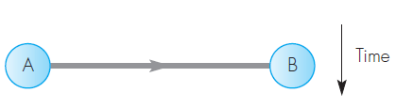
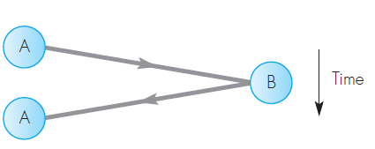
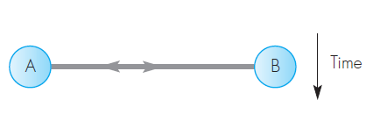
Communication modes:
Simplex
The data associated with the application flows in one direction only.
Eg: transmission of photographic images from a deep-space probe at predetermined times since this involves just a unidirectional flow of data from the probe to an earth station;
Half-Duplex
The data flows in both directions but alternately.
This mode is also known as two-way alternate
Eg: user making a request for some data from a remote server and the latter returning the requested data;
Duplex:
The data flows in both directions simultaneously.
It is also known as two-w ay simultaneous
Eg: the two-way flow of digitized speech associated with a telephony application;

Slide 86
Addressing
Address - Byte string that identifies a node.
Network can use a node’s address to distinguish it from the other nodes connected to the network.
Types of Addressing
Physical
Logical
Port

Slide 87
Physical Address
A link-layer address is variously called a LAN address, a physical address, or a MAC address
MAC address is 6 bytes long, giving 2⁴⁸ possible MAC addresses
Expressed in hexadecimal notation, with each byte of the address expressed as a pair of hexadecimal numbers.
MAC addresses were designed to be permanent- MAC address has a flat structure and doesn’t change no matter where the adapter is.
analogous to a person’s social security number.
IEEE manages the MAC address space
IEEE allocates the chunk of 2²⁴ addresses by fixing the first 24 bits of a MAC address and letting the company create unique combinations of the last 24 bits for each adapter.
Example MAC Address:
49-BD-D2-C7-56-2A

Slide 88
Logical Address
In the Internet, the host is identified by its IP address.
an IP address is a 32-bit(four bytes) quantity that we can identifying the host.
uniquely
In an IP address, each period separates one of the bytes expressed in decimal notation from 0 to 255.
An IP address is hierarchical because as we scan the address from left to right, we obtain more and more specific information about where the host is located in the Internet (ie, within which network, in the network of networks)
host’s IP addresses needs to be changed when the host moves, i.e, changes the network to which it is attached.
An IP address is analogous to a person’s postal address
Example IP Address:
222.222.222.220

Slide 89
Port Number
Message sending process must identify the receiving process running in the host because in general, a host could be running many network applications.
This is done by Port Number
Port Number is a 16 bit number.
Types:
System Ports/Well Known Ports - 0 to 1023 (assigned by IANA)
User Ports/Registered Ports - 1024 to 49151 (assigned by IANA)
Dynamic Ports/Private or Ephemeral Ports – 49152 to 65535 (never assigned)
Eg:
Web server is identified by port number 80.
A mail-server process is identified by port number 25.

Slide 90
Who assigns the IP addresses and port numbers?
Internet Assigned Numbers Authority (IANA)
https://www.iana.org

Slide 91
Bits & Bytes
1 bit = 0 or 1
1 Byte = 8 bits
1 Nibble = 4 bits

Slide 92
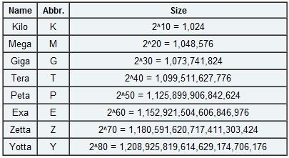
Bits & Bytes

Slide 93
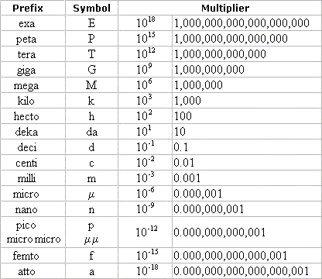
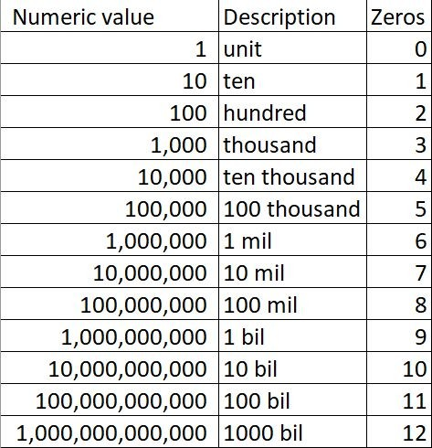
Bits & Bytes

Slide 94
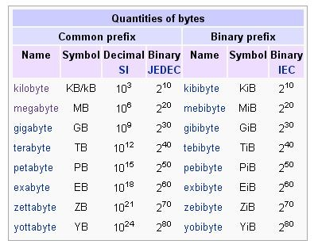
Bits & Bytes
□ 10³=1000
□ 2¹⁰= 1024
□ 10⁶=1000000
□ 2²⁰=1048576

Slide 95
Network Performance
Two measures
Bandwidth/throughput
The bandwidth of a network is given by the number of bits that can be transmitted over the network in a certain period of time
latency/delay
how long it takes a message to travel from one end of a network to the other

Slide 96
Bandwidth/Throughput
The bandwidth of a network is given by the number of bits that can be transmitted over the network in a certain period of time
Bandwidth = No of bits / Time
□ Eg: Bandwidth of 10 million bits/second (Mbps), meaning that it is able to deliver 10 million bits every second.

Slide 97
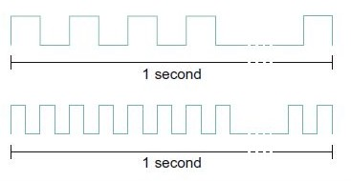
Bandwidth/Throughput – Example
Bandwidth in terms of how long it takes to transmit each bit of data.
Eg: On a 10-Mbps network, it takes 0.1 microsecond (μs) to transmit each bit.
Egs:
Each bit on a 1-Mbps link is 1 μs wide
Each bit on a 2-Mbps link is 0.5 μs wide
*Thus, the narrower each bit can become the higher is the bandwidth!

Slide 98
Bandwidth Vs Throughput – How people might use them?
Word bandwidth is literally a measure of the width of a frequency band. (probably refers to the range of signals that can be accommodated)
Eg: a voice-grade telephone line supports a frequency band ranging from 300 to 3300 Hz - it is said to have a bandwidth of 3300 Hz−300 Hz = 3000 Hz
Word bandwidth in communication link is the number of bits per second (data rate) that can be transmitted on the link.
Eg: bandwidth of an Ethernet link is 10 Mbps.

Slide 99
Bandwidth Vs Throughput – How people might use them?
Word throughput generally refers to the measured performance of a system.
Eg: Because of various inefficiencies of implementation, a pair of nodes connected by a link with a bandwidth of 10 Mbps might achieve a throughput of only 2 Mbps. This would mean that an application on one host could send data to the other host at 2 Mbps.

Slide 100
Latency/Delay
Latency is measured strictly in terms of time.
How long it takes a message to travel from one end of a network to the other.
Eg: a transcontinental network might have a latency of 24 milliseconds(ms)
round-trip time (RTT)
send a message from one end of a network to the other and back.

Slide 101
Latency/Delay - Components
Propagation Delay (speed-of-light propagation delay)
The time required to propagate from the beginning of the link to end is the propagation delay. The bit propagates at the propagation speed of the link.
light travels across different media at different speeds
Eg: It travels at
3.0×10⁸ m/s in a vacuum,
2.3×10⁸ m/s in a copper cable,
2.0×10⁸ m/s in an optical fiber.

Slide 102
Latency/Delay - Components
Transmission Delay (amount of time taken to transmit a unit of data)
function of the network bandwidth and the size of the packet in which the data is carried
Queuing Delay (Delays inside the network) packet switches generally need to store packets for some time before forwarding them on an outbound link.
Processing Delay: is the time it takes routers
to process the packet header. processing delays in high-speed routers are typically on the order of microseconds or less.

Slide 103
Propagation Delay Vs Transmission Delay
The transmission delay is the amount of time required for the (router) to push out the packet.
it is a function of the packet’s length and the transmission rate of the link
Transmit = Size / Bandwidth
The propagation delay, on the other hand, is the time it takes a bit to propagate from one (router) to the next
it is a function of the distance between the two (routers).
Propagation = Distance / Speed-of-Light

Slide 104
Latency/Delay
Total Latency = Propagation + Transmit + Queue
Propagation = Distance / Speed-of-Light
Transmit = Size / Bandwidth
Distance- length of the wire over which the data will travel
Speed-of-Light - the effective speed of light over that wire,
Size - the size of the packet
Bandwidth-the bandwidth at which the packet is transmitted.
*if the message contains only one bit and single link, then the Transmit and Queue terms are not relevant, and latency corresponds to the propagation delay only.

Slide 105
Problem!!!
□ How long does it take to transmit x KB over a
y-Mbps link? Give your answer as a ratio of x and y.
x KB is 8 × 1024 × x bits.
y Mbps is y × 10^6 bps;
The transmission time would be
□ 8 × 1024 × x/y × 10^6 sec = 8.192x/y ms.

Slide 106
Problem
□ Consider a point-to-point link 4 km in length. At what bandwidth would propagation delay (at a speed of 2×10⁸m/s) equal transmit delay for 100-byte packets? What about
512-byte packets?
Sol
Prop delay = Trans Delay
□ =4x 10^7 bits/sec
□ = 40 Mbps
What about 512-byte packets?
= 204.8 Mbps

Slide 107
Problems!!!
Consider a point-to-point link 50 km in length. At what bandwidth would propagation delay (at a speed of 2×10⁸m/s) equal transmit delay for 100-byte packets? What about 512-byte packets?
Solution
If Size =100B, Bandwidth =3.2 Mbps If Size=512B, Bandwidth = 16.4 Mbps
How “wide” is a bit on a 10-Gbps link? How long is a bit in copper wire, where the speed of propagation is 2.3×10⁸ m/s?
solution
10 Gbps = 10^10 bps, meaning each bit is 10^−10 sec (0.1 ns) wide.
The length in the wire of such a bit is
0.1 ns × 2.3 × 10^8 m/sec = 0.023 m or 23mm

Slide 108
Problems
Calculate the latency (from first bit sent to last bit received) for the following:
100-Mbps Ethernet with a single store-and-forward switch in the path and a packet size of 12,000 bits. Assume that each link introduces a propagation delay of 10 μs and that the switch begins retransmitting immediately after it has finished receiving the packet.
Same as (a) but with three switches.
Same as (a), but assume the switch implements “cut-through” switching; it is able to begin retransmitting the packet after the first 200 bits have been received.

Slide 109
Problems!!!
(a) 100-Mbps Ethernet with a single store-and-forward switch in the path and a packet size of 12,000 bits. Assume that each link introduces a propagation delay of 10 μs and that the switch begins retransmitting immediately after it has finished receiving the packet.
A
S
B
Total Latency = 2x Tras.Delay+2x Prop. Delay
= 2x 12000/100x10^6+2x10 μs
= 260 µs

Slide 110
□ (b) Same as (a) but with three switches.
A
S1
S2
S3
B
Total Latency = 4x Tras.Delay+4x Prop. Delay
= 4x 12000/100x10^6+4x10 μs
= 520 µs

Slide 111
□ (c) Same as (a), but assume the switch implements
“cut-through” switching; it is able to begin retransmitting the packet after the first 200 bits have been received.
□ Solution
With cut-through, switch delays the packet by 200 bits= 2 µs Delay = 120 µs+2 µs+20 µs
= 142 µs

Slide 112
Problems
Calculate the total time required transferring a 1000KB file in the following cases, assuming an RTT of 50ms, a packet size of 1 KB data, and an initial 2×RTT of “handshaking” before data is sent:
(a)The bandwidth is 1.5 Mbps, and data packets can be sent continuously.
The bandwidth is 1.5 Mbps, but after we finish sending each data packet we must wait one RTT before sending the next.
(c) The bandwidth is “infinite,” meaning that we take transmit time to be zero, and up to 20 packets can be sent per RTT.
(d) The bandwidth is infinite, and during the first RTT we can send one packet (2 ^1−1 ), during the second RTT we can send two packets (2 ^2−1 ), during the third we can send four (2 ^3−1 ), and so on.

Slide 113
Solutions
The bandwidth is 1.5 Mbps, and data packets can be sent continuously.
Total time = 2* RTT + Trans. Time + Pro.delay
Total time =5.586 sec
(b) The bandwidth is 1.5 Mbps, but after we finish sending each data packet we must wait one RTT before sending the next.
To the above we add the time for 999 RTTs (the number of RTTs between when packet 1 arrives and packet 1000 arrives), for a total of 5.586 + 49.95 = 55.536.

Slide 114
Solutions
The bandwidth is “infinite,” meaning that we take transmit time to be zero, and up to 20 packets can be sent per RTT.
This is 49.5 RTTs, plus the initial 2, for 2.575 seconds.
The bandwidth is infinite, and during the first RTT we can send one packet (2 ^1−1 ), during the second RTT we can send two packets (2 ^2−1
), during the third we can send four (2 ^3−1 ), and so on.
Right after the handshaking is done we send one packet. One RTT after the handshaking we send two packets.
At n RTTs past the initial handshaking we have sent 1 + 2 + 4 + · · · + 2^n = 2^(n+1) − 1 packets.
At n = 9 we have thus been able to send all 1,000 packets; the last batch arrives 0.5 RTT later.
Total time is 2+9.5 RTTs, or .575 sec.

Slide 115
Performance Characteristics
Bandwidth and latency combine to define the performance characteristics of a given link or channel.
Their relative importance, depends on the application.
For some applications, latency dominates bandwidth and vice versa.

Slide 116
Latency Dominates!
Consider a client that sends a 1-byte message to a server and receives a 1-byte message in return.
Assume that no serious computation is involved in preparing the response.
The application will perform much differently on a transcontinental channel with a 100-ms RTT than it will on an across-the-room channel with a 1-ms RTT.
Whether the channel is 1 Mbps or 100 Mbps is relatively insignificant, however, since the former implies that the time to transmit a byte (Transmit) is 8 μs and the latter implies Transmit = 0.08 μs.

Slide 117
Bandwidth Dominates!
Consider a digital library program that is being asked to fetch a 25-megabyte (MB) image.
the more bandwidth that is available, the faster it will be able to return the image to the user.
Here, the bandwidth of the channel dominates performance.
Suppose that the channel has a bandwidth of 10 Mbps. It will take 20 seconds to transmit the image (25×10⁶ ×8 bits ÷10×10⁶ Mbps = 20 seconds), making it relatively unimportant if the image is on the other side of a 1-ms channel or a 100-ms channel;
The difference between a 20.001-second response time and a 20.1-second response time is negligible.

Slide 118
Pause!!!
For each of the following operations on a remote file server, discuss whether they are more likely to be delay sensitive or bandwidth sensitive:
Open a file.
Read the contents of a file.
List the contents of a directory.
Display the attributes of a file.

Slide 119
Delay-sensitive; the messages exchanged are short.
Bandwidth-sensitive, particularly for large files. that the underlying protocol uses a large message size or window size.
(c) Delay-sensitive; directories are typically of modest size.
(d) Delay-sensitive; a file’s attributes are typically much smaller than the file itself.

Slide 120
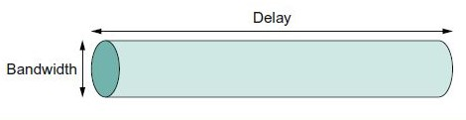
Delay X Bandwidth Product
Consider a channel between a pair of processes as a hollow pipe where,
latency - the length of the pipe
bandwidth - the diameter of the pipe,
Then the delay × bandwidth product gives the volume of the pipe.
It is the maximum number of bits that could be in transit through the pipe at any given instant.

Slide 121
Delay X Bandwidth Product
Example
A transcontinental channel with a one-way latency of 50 ms and a bandwidth of 45 Mbps is able to hold,
50×10⁻³s×45×10⁶bits/s
= 2.25×10⁶bits
or approximately 280 KB of data.
Usually, whether the “delay” in “delay × bandwidth” means one-way latency or RTT is made clear by the context

Slide 122
Delay X Bandwidth Product
The delay × bandwidth product is important to know when constructing high-performance networks because
it corresponds to how many bits the sender must transmit before the first bit arrives at the receiver.
If the sender is expecting the receiver to somehow signal that bits are starting to arrive, and it takes another channel latency for this signal to propagate back to the sender,
then the sender can send up one RTT× bandwidth worth of data before hearing from the receiver that all is well.
The bits in the pipe are said to be “in flight,” which means that if the receiver tells the sender to stop transmitting it might receive up to one RTT×bandwidth’s worth of data before the sender manages to respond.

Slide 123
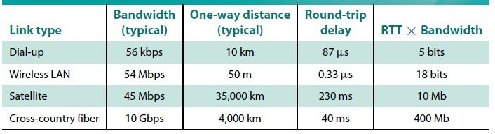
Sample Delay X Bandwidth Products

Slide 124
Significance of ever-increasing bandwidth
Consider transmit of a 1-MB file with RTT of 100 ms
If Bandwidth = 1-Mbps
If Bandwidth = 1-Gbps
If Bandwidth = 1-Mbps, it takes 80 round-trip times to transmit the file; during each RTT, 1.25% of the file is sent.
If Bandwidth = 1-Gbps 1-MB file doesn’t even come close to filling 1 RTT’s worth of the 1-Gbps link, which has a delay×bandwidth product of 12.5 MB

Slide 125
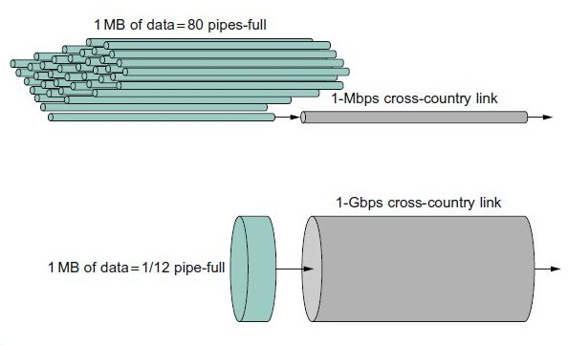
Significance of ever-increasing bandwidth
the 1-MB file looks like a stream of data that needs to be transmitted across a 1-Mbps network,
while it looks like a single packet on a 1-Gbps network.

Slide 126
Problems
Suppose a 1-Gbps point-to-point link is being set up between the Earth and a new lunar colony. The distance from the moon to the Earth is approximately 385,000 km, and data travels over the link at the speed of light 3 × 10^8 m/s.
(a) Calculate the minimum RTT for the link.
(b) Using the RTT as the delay, calculate the delay × bandwidth product for the link.
What is the significance of the delay × bandwidth product computed in (b)?
(d) A camera on the lunar base takes pictures of the Earth and saves them in digital format to disk. Suppose Mission Control on Earth wishes to download the most current image, which is 25 MB. What is the minimum amount of time that will elapse between when the request for the data goes out and the transfer is finished?

Slide 127
Solutions
minimum RTT for the link.
The minimum RTT = 2x propagation delay
2 × 385, 000, 000 m / 3×10^8 m/s
= 2.57 seconds.
The delay×bandwidth product is 2.57 s×1 Gbps
= 2.57Gb = 321 MB.
This represents the amount of data the sender can send before it would be possible to receive a response.

Slide 128
Solutions
(d) A camera on the lunar base takes pictures of the Earth and saves them in digital format to disk. Suppose Mission Control on Earth wishes to download the most current image, which is 25 MB. What is the minimum amount of time that will elapse between when the request for the data goes out and the transfer is finished?
We require at least one RTT from sending the request before the first bit of the picture could begin arriving at the ground (TCP would take longer). 25 MB is 200Mb.
Assuming bandwidth delay only, it would then take 200Mb/1000Mbps = 0.2 seconds to finish sending, for a total time of 0.2+ 2.57 = 2.77 sec until the last picture bit arrives on earth.

Slide 129
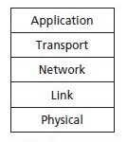
5-Layer Model-TCP/IP Architecture

Slide 130
TCP/IP Architecture
Application Layer
The application layer is where network applications and their application-layer protocols reside.
An application-layer protocol is distributed over multiple end systems, with the application in one end system using the protocol to exchange packets of information with the application in another end system.
packet of information at the application layer is message.
Egs: The Internet’s application layer includes many protocols:
HTTP protocol - which provides for Web document request and transfer,
SMTP - which provides for the transfer of e-mail messages,
FTP - which provides for the transfer of files between two end systems

Slide 131
TCP/IP Architecture
□ Transport Layer
Concerned with process-to-process delivery of information.
The Internet’s transport layer transports application-layer messages between application endpoints.
Transport-layer packet called as a segment.
Eg: In the Internet there are two transport protocols, TCP and UDP, either of which can transport application-layer messages.
TCP provides a connection-oriented service to its applications.
This service includes guaranteed delivery of application-layer messages to the destination and flow control and
congestion-control mechanism.
The UDP protocol provides a connectionless service to its applications.
This is a no-frills service that provides no reliability, no flow control, and no congestion control.

Slide 132
TCP/IP Architecture
Network Layer
The Internet’s network layer is responsible for moving network-layer packets known
as datagrams from one host to another
The network layer then provides the service of delivering the datagram to the transport layer in the destination host
The Internet’s network layer includes the celebrated IP Protocol, which defines the fields in the datagram as well as how the end systems and routers act on these fields.
There is only one IP protocol, and all Internet components that have a network layer must run the IP protocol.
The Internet’s network layer also contains routing protocols that determine the routes that datagrams take between sources and destinations.

Slide 133
TCP/IP Architecture
Data Link Layer
Organizes the bit stream into a data unit called a “frame” and delivers the
frame to an adjacent system.
The services provided by the link layer depend on the specific link-layer protocol that is employed over the link.
For example, some link-layer protocols provide reliable delivery, from transmitting node, over one link, to receiving node.
Datagrams typically need to traverse several links to travel from source to destination, a datagram may be handled by different link-layer protocols at different links along its route.
Eg: Ethernet, WiFi, and the cable access network’s DOCSIS(Data Over Cable Service Interface Specification) protocol.

Slide 134
TCP/IP Architecture
Physical Layer
The functions needed to carry the bit stream over a physical medium to another system.
The job of the physical layer is to move the individual bits from one node to the next
The protocols in this layer are link dependent and further depend on the actual transmission medium of the link (for example, twisted-pair copper wire, fiber optics).
Eg: Ethernet has many physical-layer protocols: one for twisted-pair copper wire, another for coaxial cable, another for fiber, and so on. In each case, a bit is moved across the link in a different way.

